Slide 1
System analysis and design
Define information systems analysis and design
Discuss the modern approach to systems analysis and design
Describe the organizational roles involved in information systems development
1.2

Slide 2
Learning Objectives
Describe four types of information systems:
  Transaction Processing Systems (TPS)
  Management Information Systems (MIS)
  Decision Support Systems (DSS)
  Expert Systems (ES)
Describe the information systems development life cycle (SDLC)
1.3

Slide 3
Learning Objectives
Discuss alternatives to the systems development life cycle
Discuss the role of computer-aided software engineering (CASE) tools in systems development
1.4

Slide 4
Introduction
Information Systems Analysis and Design
  Complex process whereby computer-based information systems are developed and maintained
Application Software
  Result of systems analysis and design
  Designed to support specific organizational functions or processes
1.5

Slide 5
Introduction
Software engineering processes have been developed to assist in analysis and design
  Methodologies
    Comprehensive, multi-step approaches to systems development
  Techniques
    Processes that are followed to ensure that work is well thought-out, complete and comprehensible to others on the project team
  Tools
    Computer programs to assist in application of techniques to the analysis and design process
1.6

Slide 6
Introduction
Information Systems Analysis and Design
  A method used by companies to create and maintain systems that perform basic business functions
  Main goal is to improve employee efficiency by applying software solutions to key business tasks
  A structured approach must be used in order to ensure success
1.7

Slide 7
Introduction
Systems Analyst performs analysis and design based upon:
  Understanding of organization’s objectives, structure and processes
  Knowledge of how to exploit information technology for advantage
1.8

Slide 8
Software Engineering Process
A process used to create an information system
Consists of:
  Methodologies
    A sequence of step-by-step approaches that help develop the information system
  Techniques
    Processes that the analyst follows to ensure thorough, complete and comprehensive analysis and design
  Tools
    Computer programs that aid in applying techniques
1.11

Slide 9
Data and Processes
Three key components of an information system
  Data
  Data Flows
  Processing Logic
Data vs. Information
  Data
    Raw facts
  Information
    Derived from data
    Organized in a manner that humans can
    understand.
1.<number>

Slide 10
Data and Processes
Data
  Understanding the source and use of data is key to good system design
  Various techniques are used to describe data and the relationship amongst data
Data Flows
  Groups of data that move and flow through the system
1.<number>

Slide 11
Data and Processes
Data Flows (Continued)
  Include description of sources and destination for each data flow
Processing Logic
  Describe steps that transform data and events that trigger the steps
1.<number>

Slide 12
Information Stock holder
System Owners
System Users
System Designer
System Analysts
Project Manager

Slide 13
Organizational Responsibilities in Systems Development
IS Manager
  May have a direct role in systems development if the project is small
  Typically involved in allocating resources to and overseeing system development projects.
Systems Analyst
  Key individuals in the systems development process

Slide 14
Organizational Responsibilities in Systems Development
Skills of a Successful Systems Analyst
  Analytical
    Understanding of organizations
    Problem solving skills
    System thinking
      Ability to see organizations and information systems as systems
  Technical
    Understanding of potential and limitations of technology
  Management
    Ability to manage projects, resources, risk and change
  Interpersonal
    Effective written and oral communication skills
1.<number>

Slide 15
Organizational Responsibilities in Systems Development
Programmers
  Convert specifications into instructions that the computer understands
  Write documentation and testing programs
Business Managers
  Have power to fund projects and allocate resources
  Set general requirements and constraints for projects
1.<number>

Slide 16
Organizational Responsibilities in Systems Development
Other IS Managers/Technicians
  Database Administrator
    Involved in design, development and maintenance of databases
  Network and telecommunications experts
    Develop systems involving data and/or voice communications
  Human Factors Specialists
    Involved in training users and writing documentation
  Internal Auditors
    Ensure that required controls are built into the system
1.<number>

Slide 17
Types of Information Systems and Systems Development
Transaction Processing Systems (TPS)
  Automate handling of data about business activities (transactions)
Management Information Systems (MIS)
  Converts raw data from transaction processing system into meaningful form
Decision Support Systems (DSS)
  Designed to help decision makers
  Provides interactive environment for decision making
1.<number>

Slide 18
Types of Information Systems and Systems Development
Expert Systems (ES)
  Replicates decision making process
  Knowledge representation describes the way an expert would approach the problem
1.<number>

Slide 19
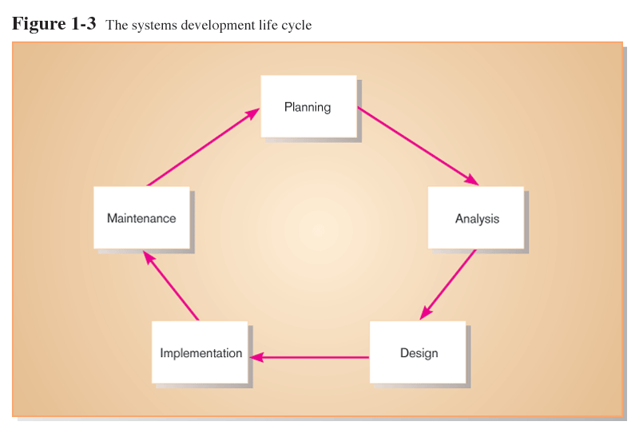
System Development life cycle

Slide 20
Systems Development Life Cycle
System Development Methodology
  Standard process followed in an organization
  Consists of:
    Analysis
    Design
    Implementation
    Maintenance
1.<number>

Slide 21
Systems Development Life Cycle
Series of steps used to manage the phases of development for an information system
Consists of six phases:
  Project Identification and Selection
  Project Initiation and Planning
  Analysis
  Design
  Implementation
  Maintenance
1.<number>

Slide 22
Systems Development Life Cycle
  Phases are not necessarily sequential
  Each phase has a specific outcome and deliverable
  Individual companies use customized life cycles
1.<number>

Slide 23
Phases of the Systems Development Life Cycle
Project Identification and Selection
  Two Main Activities
    Identification of need
    Prioritization and translation of need into a development schedule
  Helps organization to determine whether or not resources should be dedicated to a project.
Project Initiation and Planning
  Two Activities
    Formal preliminary investigation of the problem at hand
    Presentation of reasons why system should or should not be developed by the organization
1.<number>

Slide 24
Systems Development Life Cycle
Analysis
  Study of current procedures and information systems
    Determine requirements
      Study current system
      Structure requirements and eliminate redundancies
    Generate alternative designs
    Compare alternatives
    Recommend best alternative
1.<number>

Slide 25
Systems Development Life Cycle
Design
  Logical Design
    Concentrates on business aspects of the system
  Physical Design
    Technical specifications
Implementation
  Implementation
    Hardware and software installation
    Programming
    User Training
    Documentation
1.<number>

Slide 26
Systems Development Life Cycle
Maintenance
    System changed to reflect changing conditions
    System obsolescence
1.<number>

Slide 27
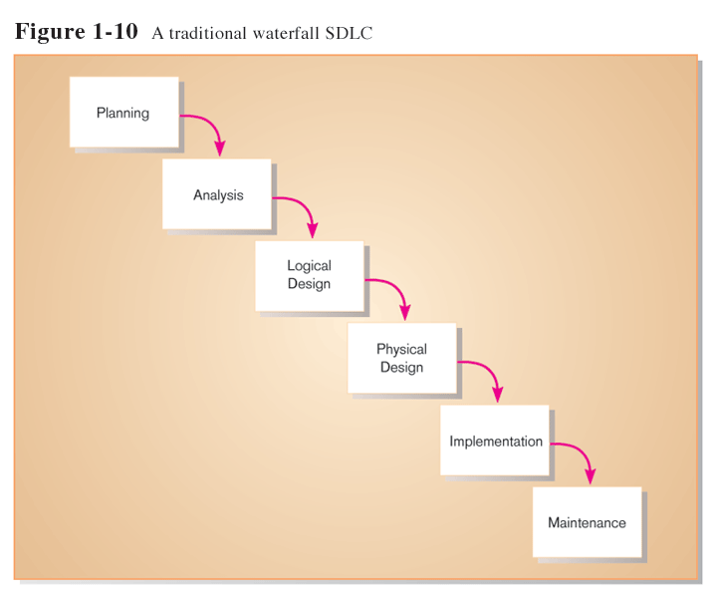
Approaches to Development
Water fall model

Slide 28
Advantages
It is simple model suitable for small size project
It is less expensive

Slide 29
Disadvantage
It has no back track mechanism.
It is not suitable for large size project.
It has lack of proper documentation.

Slide 30
Approaches to Development
Prototyping
  Building a scaled-down working version of the system
  Advantages:
    Users are involved in design
    Captures requirements in concrete form
1.<number>

Slide 31
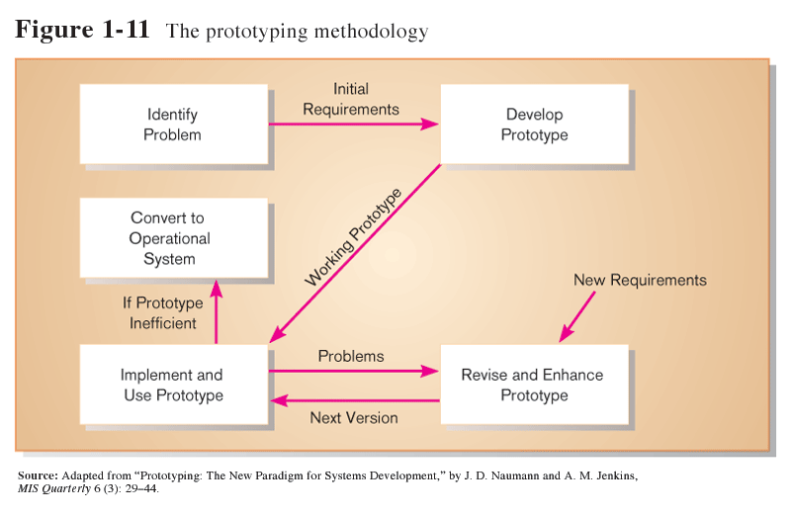
Cont….

Slide 32
Advantages
Communication between the systems analyst and user are improved
The expert can do a better job of determining the user’s needs.
The user plays a more active role in system development.
The expert and the user spend less time and effort in developing the systems

Slide 33
Cont…
A system is developed through operational prototyping is capable of easy adaptation.

Slide 34
disadvantages
Because of the iterative nature of prototyping , these is no definite deliverable of completion deadline
Code inefficiencies may be a drawback in terms of functionality.
The computer human interface provided by certain prototyping tools may not reflect good design techniques.

Slide 35
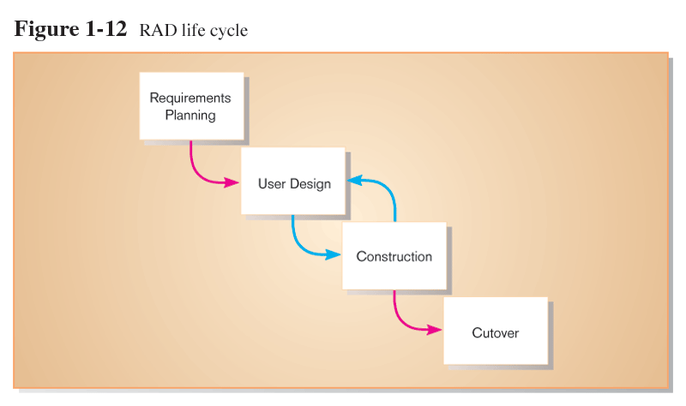
Rapid Application Development (RAD)
  Utilizes prototyping to delay producing system design until after user requirements are clear

Slide 36
Cont..
Methodology to decrease design and implementation time
Involves: prototyping, JAD, CASE tools, and code generators

Slide 37
Approaches to Development
Joint Application Design (JAD)
  Users, Managers and Analysts work together for several days
  System requirements are reviewed
  Structured meetings
1.<number>

Slide 38
Improving IS Development Productivity
Computer-aided software engineering (CASE) tools
  Facilitate creation of a central repository for system descriptions and specifications
Diagramming tools
Dictionary tools
Design tools
1.<number>

Slide 39
Cont…
Documentation tools
Quality management tools
Design and code generator tools

Slide 40
assignment
What do you mean by system analysis? Explain the system development life cycle with example.
What do you mean by system analysis? Explain the system development life cycle with example.
Explain the different types of information system.
Explain about the prototyping approach of development of information system
Write short notes about CASE Tools.
What do you mean by joint application development?
Who is the system analyst? Explain the role and characteristics of a system analyst.

